Slide 1
EOBT Prediction
Approach and Findings

Slide 2
Problem Statement
The objective is to predict EOBT
EOBT – Estimated Off Block Time
Predicting time left to departure will help in calculating EOBT
The prediction has to be made at regular intervals prior to departure of a flight

Slide 3
Objective - Example
Flight 850 is predicted to depart early at every stage of the boarding process
Flight 850 departs early by 3 mins

Slide 4
Current Model
Current process determines time to departure from historical data based on a percentile value
The percentile value is determined based on:
Equipment (Fleet Type)
Airport (Hub, Gateway, Spoke)
Bags / Passengers Left
A table with percentile value, projected time to departure is provided
Notes:
The OR team will provide a lookup table to determine time remaining until the projected ETD (out time).
To use the lookup table, the process needs to determine how many bags and passengers are left to load.
Separate tables will be provided for the calculation based on passengers and for bags.
This projection should occur at D-30, D-25, D-20, D-15, D-10 and D-5 where the D-Time is based on the
current latest out time.
ProjETD = CurrentTime
+ MAX [TimeToOutPax(Equip, Airport, Pctl, PaxLeft), TimeToOutBag(Equip, Airport, Pctl, BagsLeft)]
If Station = CLT, DFW, MIA, ORD, PHL, PHX then Airport = Hub
Else If Station = DCA, JFK, LAX, LGA the Airport = Gateway
Else Airport = Spoke
To determine what Pctl value to use, please see tables attached. Pctl is a function of Airport, Equip and
D-Time.
If Equip = 330, 767, 777, 787 then TimeToOutBag = 0
PaxLeft = TotPax – SUM(ScanEGR)
BagsLeft = TotBags – SUM(ScanBag)
If PaxLeft = 0 then TimeToOutPax should not be calculated
If BagsLeft = 0 then TimeToOutBag should not be calculated

Slide 5
Pre – Processing Steps
Obtain flight data – 1st Jan 2016 to 31st Dec 2016 for origin in DFW & CLT
Obtain passenger boarding details for the same time period
Dataset contains flights details of approx. 143,700 flights
Merge passenger boarding data with flight level data
Calculate time to departure when passenger boarding is at 5%, 25%, 50%, 75%, 95%
Time to departure = Actual dep time – Current Time
Removed time to departure values below 0.05 percentile and above 0.95 percentile
Notes:
The values were removed due to presence of negative values and very large positive values which case of broken gate or very unique delay situation

Slide 6
Data set SPLIT – Train & Test
Split the dataset into Train (70%) and Test (30%)
Train dataset – 81,431 flights
Test dataset – 34,899 Flights
Prediction algorithms
Decision Tree Regression
Random Forest Regression
Notes:
In a regression tree the idea is this: since the target variable does not have classes, we fit a regression model to the target variable using each of the independent variables. Then for each independent variable, the data is split at several split points. At each split point, the "error" between the predicted value and the actual values is squared to get a "Sum of Squared Errors (SSE)". The split point errors across the variables are compared and the variable/point yielding the lowest SSE is chosen as the root node/split point. This process is recursively continued.

Slide 7
Parameter Values
Decision Tree Regression (DTR)
Maximum Depth: 1-50
Min sample in leaf: 100
Random Forest Regression (RFR)
No of Trees: 20,100,200,300
Min samples in leaf: 100
Grid Search of algorithm parameters
Scoring parameter : Mean square error
3 fold cross validation to select best parameters
Grid Search function searches through each of the given parameters to determine the best parameters

Slide 8
Features

Slide 9
Feature Importance Matrix

Slide 10
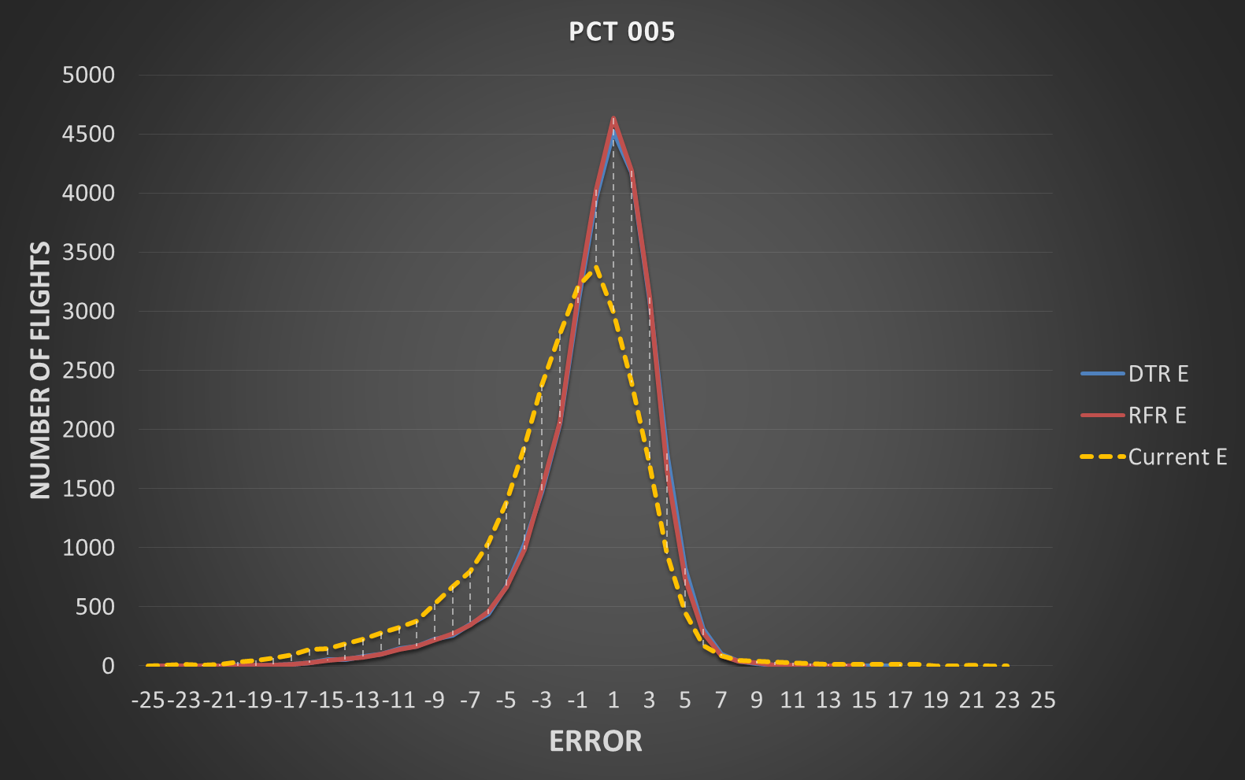
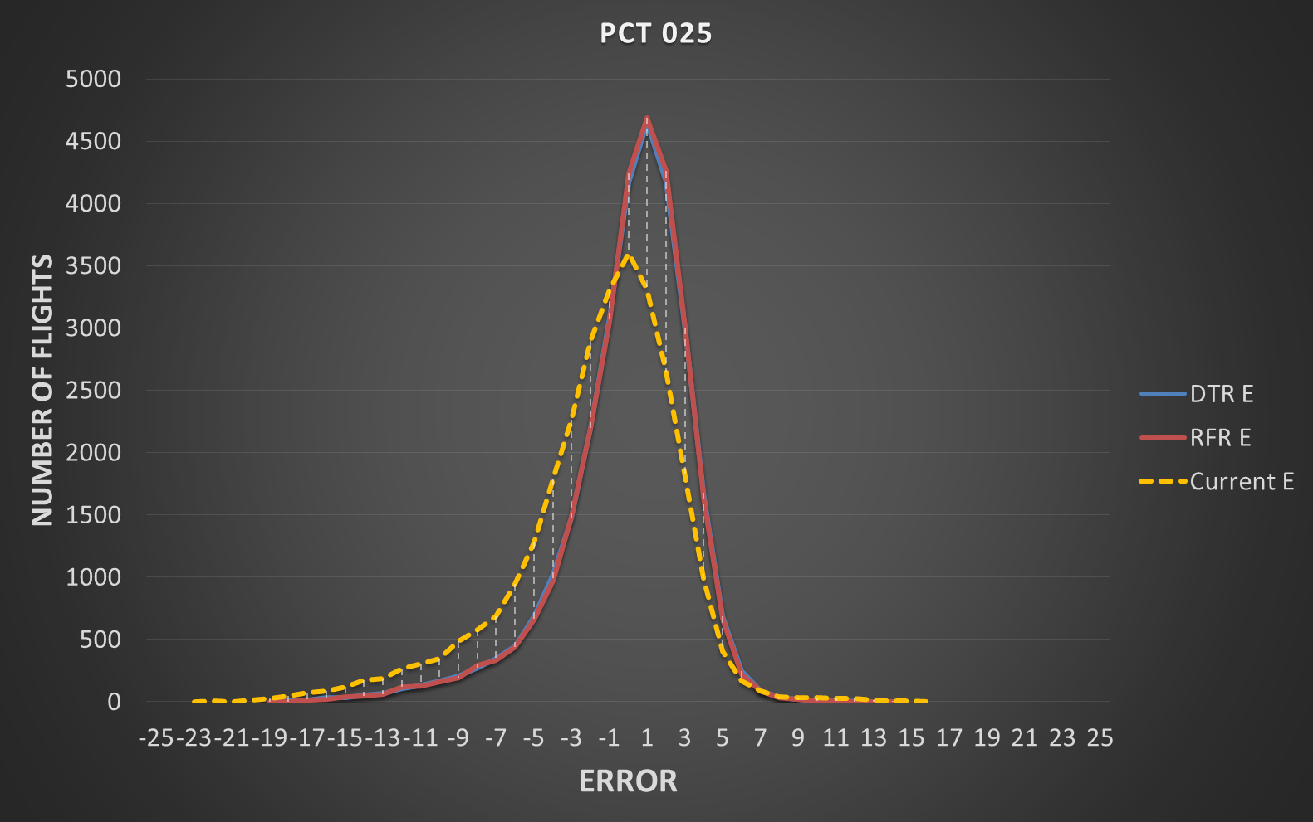
Error Distribution – PCT 005 & PCT 025
RFR – Random Forest Regression
DTR – Decision Tree Regression
Current model has larger spread of errors
Random Forest and Decision Tree have identical distribution of errors

Slide 11

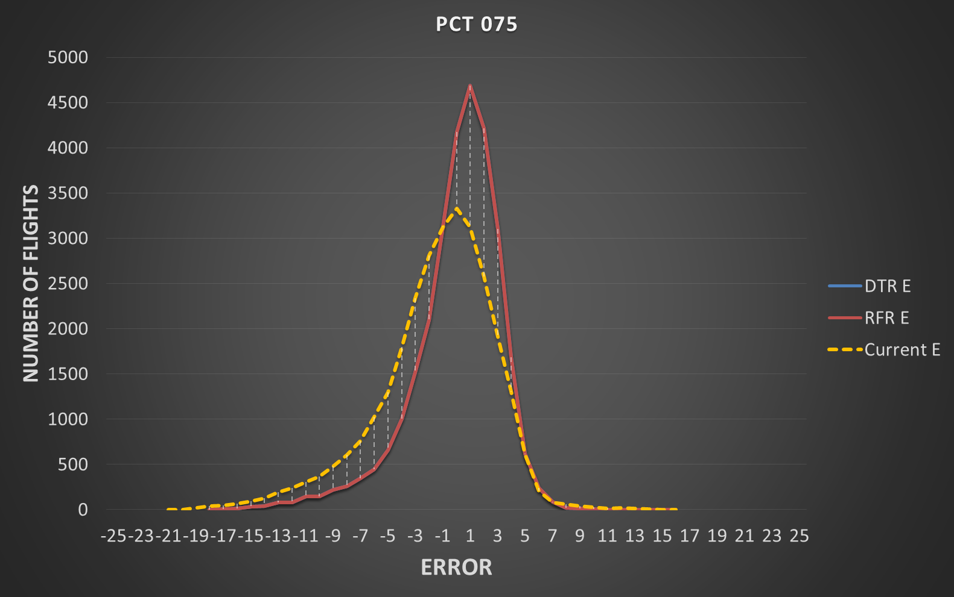
Error Distribution – PCT 050 & PCT 075

Slide 12
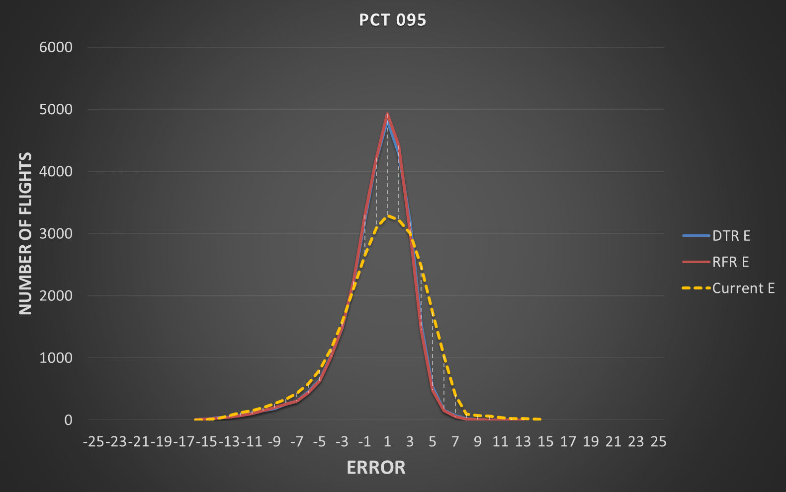
Error Distribution – PCT 95
Towards the end of passenger boarding current model shifts towards higher predictions

Slide 13
Accuracy Summary

Slide 14
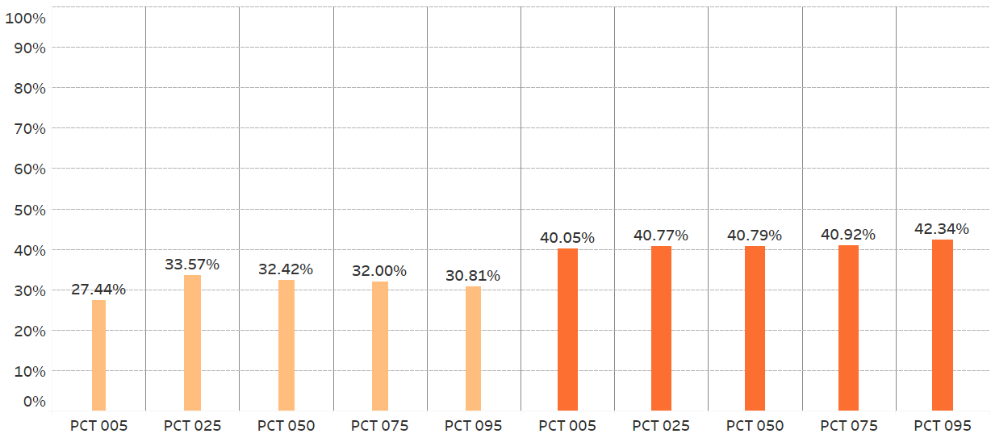
Accuracy (+/- 1min)
Current Model
Random Forest Model
Accuracy from Random Forest is consistent and higher than Current Model
Random forest is able to predict time to departure within 1 min range for 40-42% of the flights
Accuracy for current model reduces as we approach end of boarding process

Slide 15
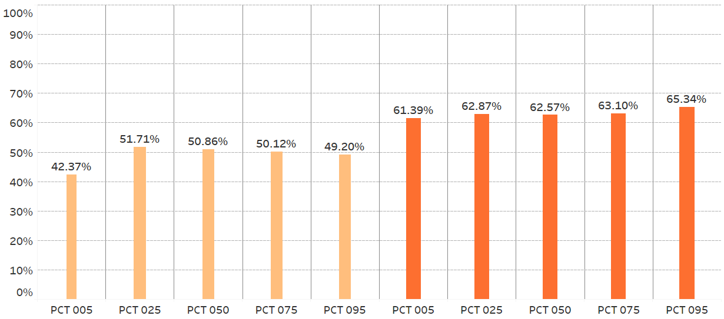
Accuracy (+/- 2 min)
Current Model
Random Forest Model
Accuracy from Random Forest is consistent and higher than Current Model
Random forest is able to predict time to departure within 2 mins range for 60-65% of the flights
Accuracy for current model reduces as we approach end of boarding process

Slide 16
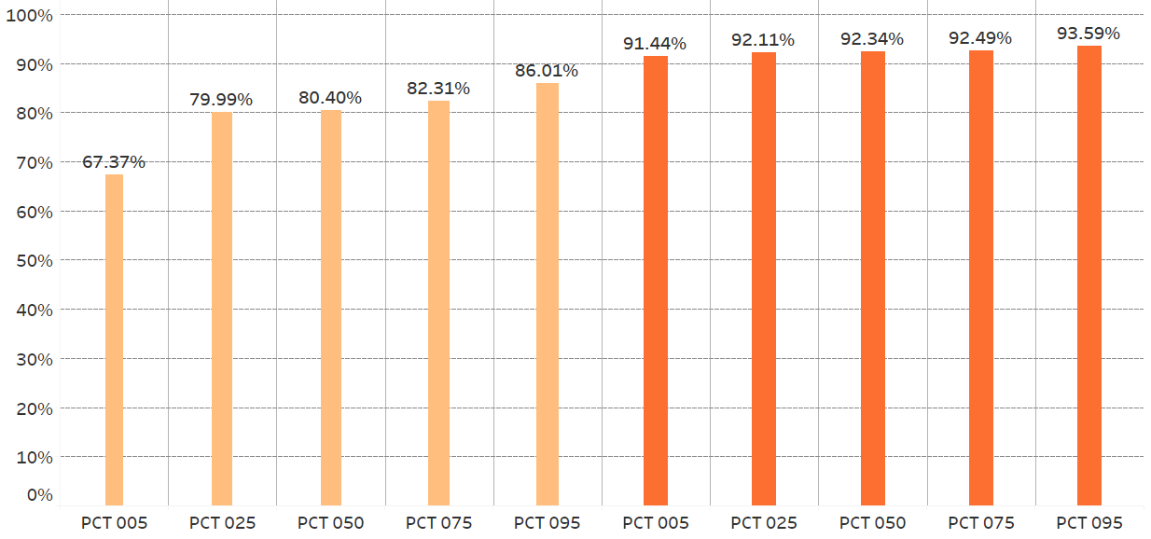
Accuracy (+/- 5 mins)
Current Model
Random Forest Model
Accuracy from Random Forest is consistent and higher than Current Model
Random forest is able to predict time to departure within 5 mins range for 91-93% of the flights

Slide 17
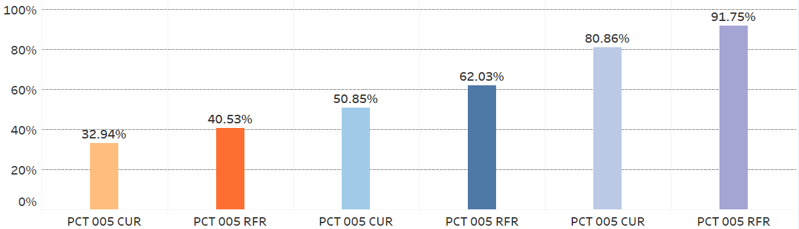
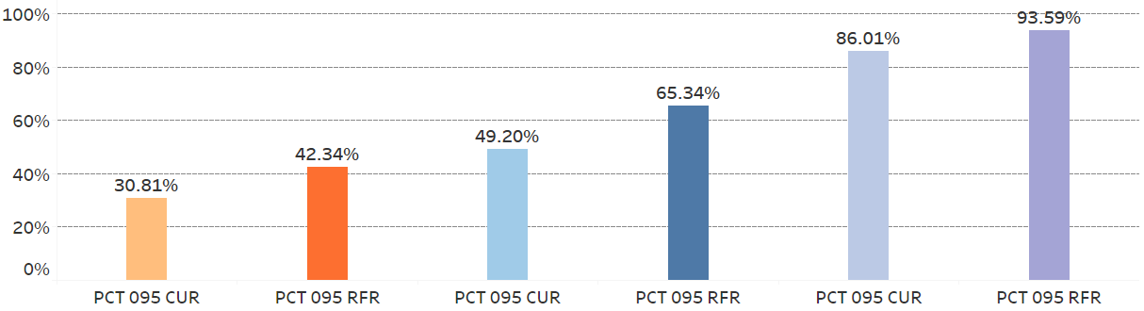
Accuracy Summary
Accuracy (+/-1 min)
Accuracy (+/-2 mins)
Accuracy (+/-5 mins)
Random Forest Model has higher accuracy than current model in all accuracy intervals

Slide 18
Performance Comparison

Slide 19
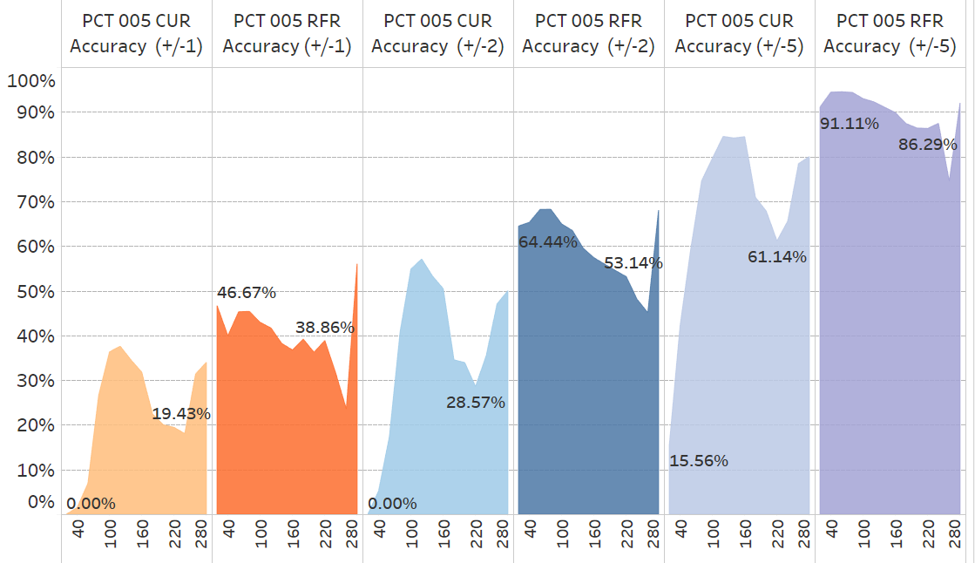
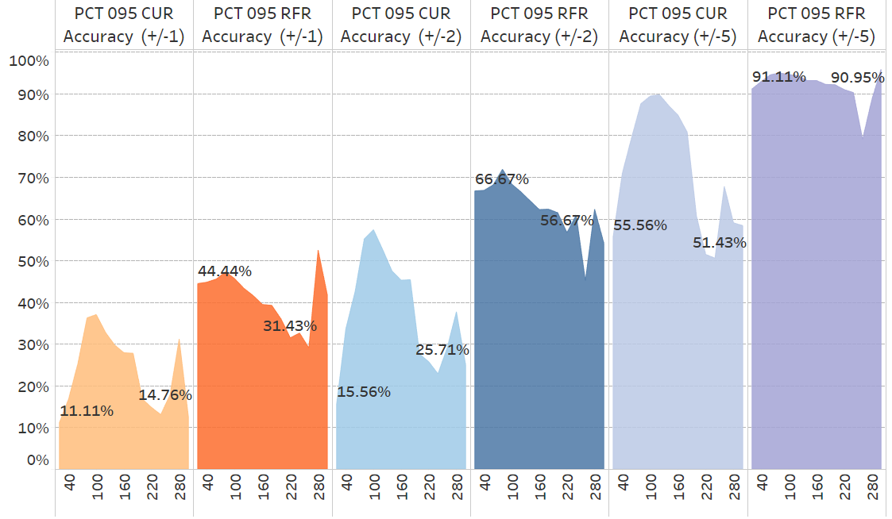
OB NUM PaX
Current model is very bad in predicting certain pockets of data
OB PAX 0-60 – most fleet type are 320 & S80
OB PAX 180 – 260 – most fleet type are 777 & 767
5% passenger boarded
95% passenger boarded
Notes:
0-60 BIN – most flights 320 and S80
180 – 260 – most flights are 777 and 767
0- 60 – 1200 flights 4% of the test data
180 – 240 – 1000 flights 3.5% of the data
AIR MIN_CAP MAX_CAP
--- ---------- ----------
319 128 128
320 150 150
321 187 187
32B 181 181
332 253 258
333 286 286
738 160 160
757 171 188
763 201 209
772 259 289
777 247 247
77W 301 310
788 225 226
789 284 285
CR7 63 70
CR9 68 76
CRJ 50 50
DH8 34 48
E75 65 76
E90 99 99
ER4 48 50
S80 140 140

Slide 20
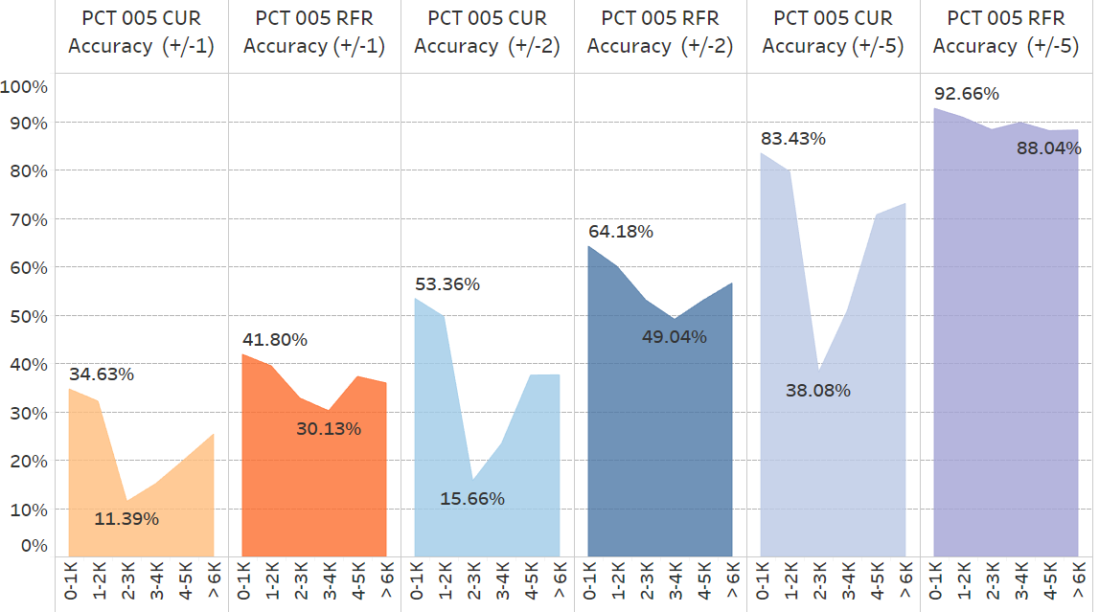
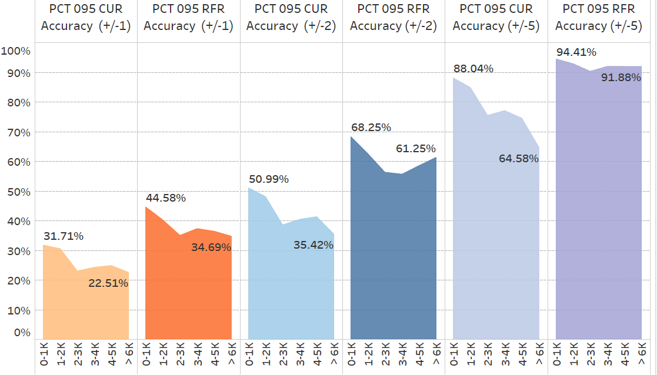
OB Length of Haul
Current model’s accuracy drops for flights with:
OB length of haul 2000-4000 at start of boarding
OB length of haul 4000-6000 towards end of boarding
5% passenger boarded
95% passenger boarded

Slide 21
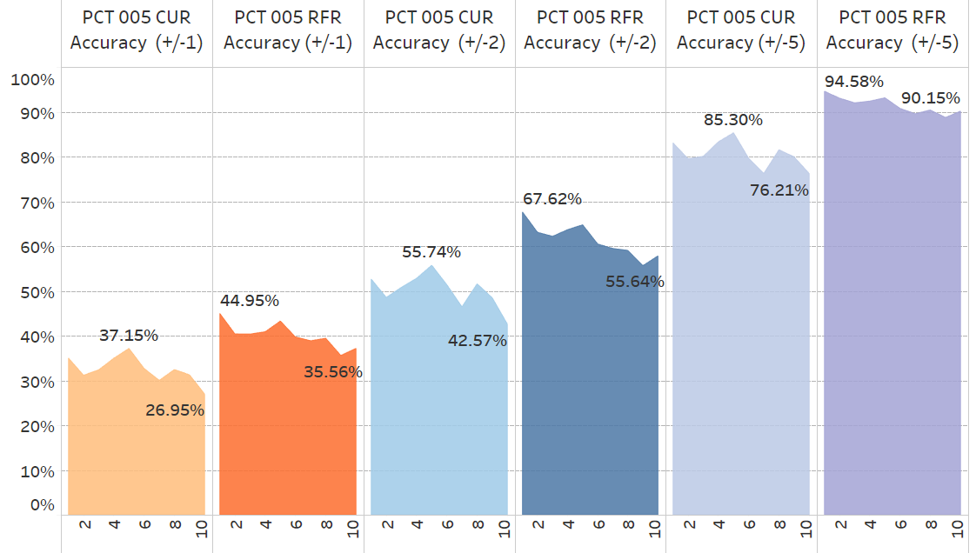
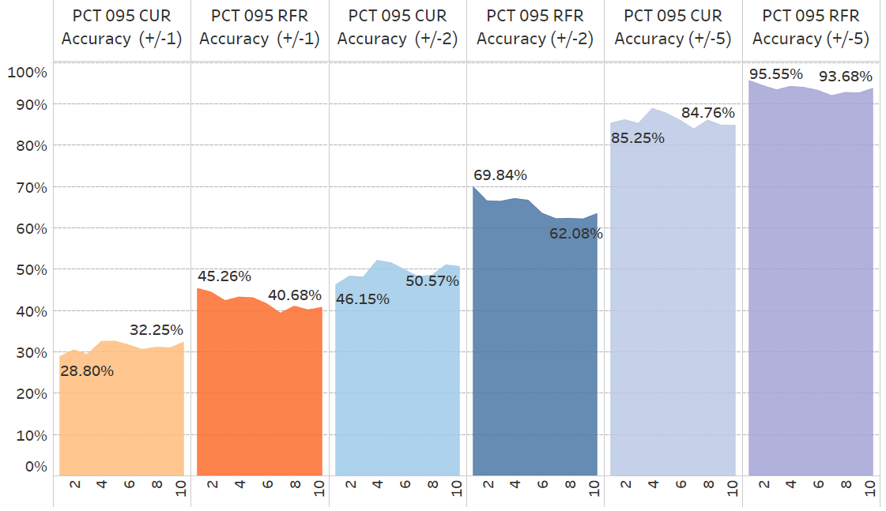
Departure BANK
Accuracy falls as we reach flights leaving at end of the day
The drop in accuracy for current model is much higher than Random Forest
Random Forest significantly outperforms the current model for the flights leaving early in the morning
5% passenger boarded
95% passenger boarded

Slide 22
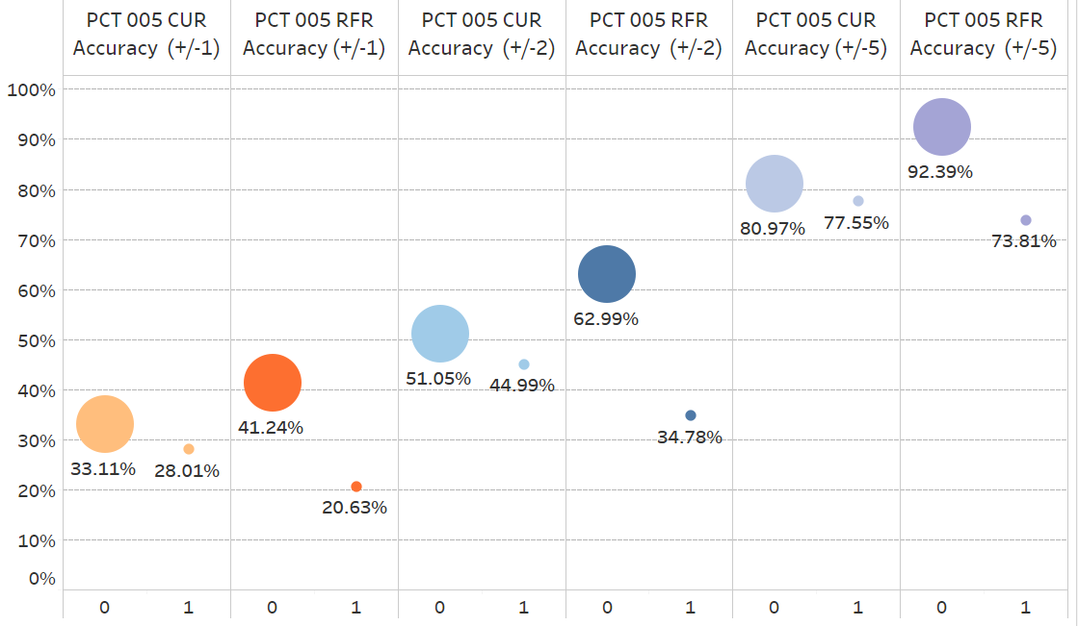
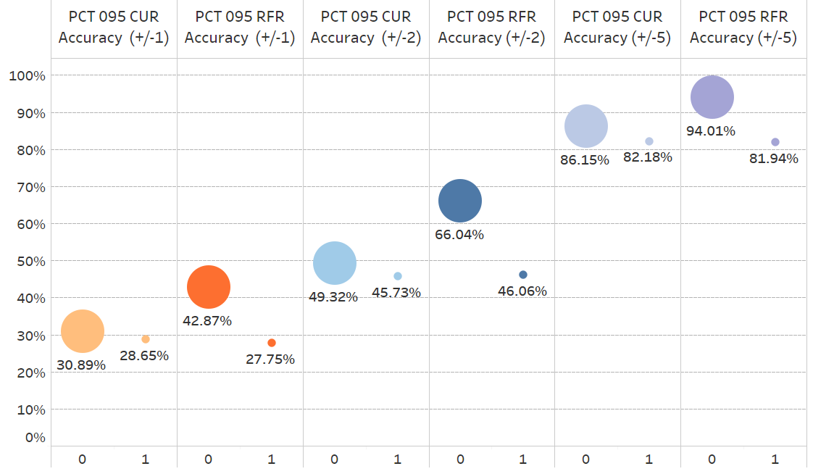
Tight Turn Indicator
Tight turn is a situation where available on-ground time is less than minimum on-ground time required for a fight
Current Model performs better for tight turns at the start of boarding
Towards end of boarding both models perform equally good for tight turns
5% passenger boarded
95% passenger boarded

Slide 23
Findings
Random Forest provides higher accuracy than current model
Random Forest is able to identify patterns in small pockets of data
Random Forest is accurate for over 90% of fights in +/- 5 mins range
Random Forest is accurate for over 60% of fights in +/- 2 mins range
Random Forest is easily scalable to be deployed on complete network

